Slide 1
Graphic Design
The “look & feel”
The system of imagery

Slide 2
Graphic Design
It shares aspects of engineering, but with aesthetic, communicative aspects and consumer appeal.

Slide 3
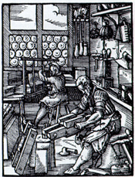
Graphic Design
With the industrial revolution, art and design began to diverge.

Slide 4
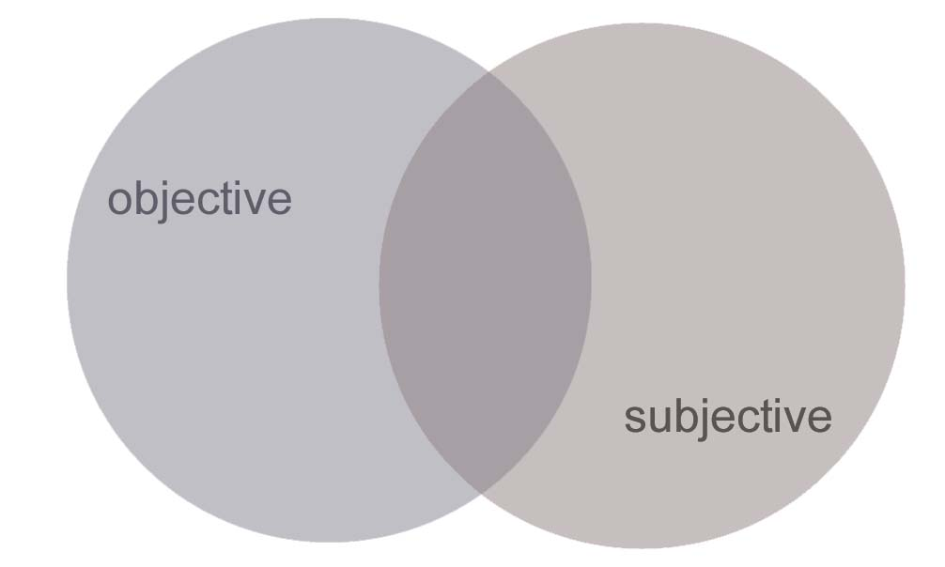
Graphic Design
It relies on a BALANCE and integration of:
& feel

Slide 5
Graphic Design
Objective: relies on quantitative studies, like usability and legibility measures. Does the “look and feel” work?

Slide 6
Graphic Design
Subjective: “look and feel” relies on subjective judgement by experts, depends on contextual factors.

Slide 7
Graphic Design
Subjective: “look and feel” Culture is learned, cultural meanings change, meanings can be multiple. Uniqueness is valued (not programmable).

Slide 8
Agenda:
The Role of Graphic Design
Principles of Graphic Design
Animation/Rollovers
Typography
Color
Icons
Sep 21, Fall 2006
IAT 410

Slide 9
Role of Graphic Design
The “look and feel” portion of an interface:
What someone initially encounters
Sep 21, Fall 2006
IAT 410

Slide 10
Role of Graphic Design
The “look and feel” portion of an interface:
What someone initially encounters
  Sets a framework for understanding content
  Conveys an impression, mood
Sep 21, Fall 2006
IAT 410

Slide 11
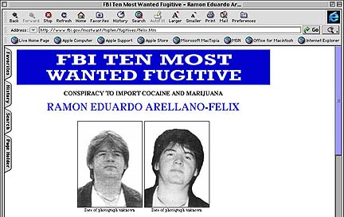
Role of Graphic Design
The “look and feel” portion of an interface:
What someone initially encounters
  Sets a framework for understanding content
Sep 21, Fall 2006
IAT 410

Slide 12
Role of Graphic Design
The “look and feel” portion of an interface:
What someone initially encounters
  Sets a framework for understanding content
Sep 21, Fall 2006
IAT 410

Slide 13
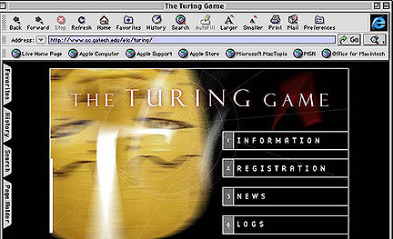
Role of Graphic Design
The “look and feel” portion of an interface:
What someone initially encounters
  Sets a framework for understanding content
Sep 21, Fall 2006
IAT 410

Slide 14
Agenda:
The Role of Graphic Design
Principles of Graphic Design
Animation/Rollovers
Typography
Color
Icons
Sep 21, Fall 2006
IAT 410

Slide 15
Principles of Graphic Design
Concept/Metaphor
Hierarchy
Clarity
Consistency
Alignment
Proximity
Contrast
Sep 21, Fall 2006
IAT 410

Slide 16
Principles: Concept/Metaphor
Concept: what is the overarching idea that every visual aspect of the interface relates to? (It MUST be relevant)
Metaphor: (Means of “explaining” concept) If you’re building an interface for a grocery application, maybe mimic a person walking through a store with a cart.
Sep 21, Fall 2006
IAT 410

Slide 17
Principles: Concept/Metaphor
Concept: what is the overarching idea that every visual aspect of the interface relates to? (It MUST be relevant)
Apple: accessible, fun, familiar; “for the rest of us”
Metaphor: (Means of “explaining” concept) If you’re building an interface for a grocery application, maybe mimic a person walking through a store with a cart. desktop metaphor
Sep 21, Fall 2006
IAT 410

Slide 18
Principles: Hierarchy
What are the relative “levels” of importance?
What should the user see first? Second?
Sep 21, Fall 2006
IAT 410

Slide 19
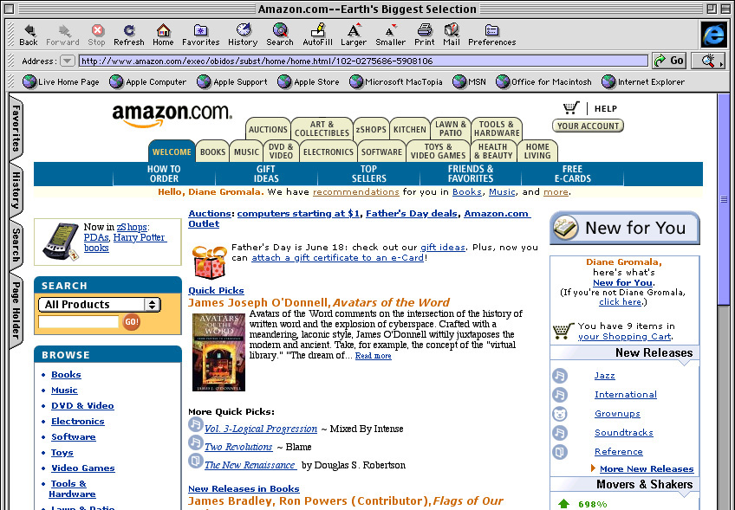
Principles: Hierarchy
What are the relative “levels” of importance?
Sep 21, Fall 2006
IAT 410

Slide 20
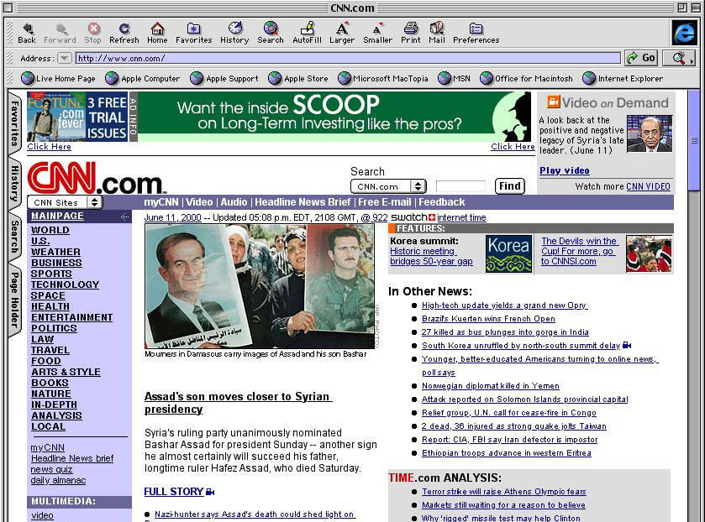
Principles: Hierarchy
.
Sep 21, Fall 2006
IAT 410

Slide 21
Principles: Clarity
Every element in an interface should have a reason for being there
  Make that reason clear!
Less is more
Sep 21, Fall 2006
IAT 410

Slide 22
Principles: Clarity
White space
  Leads the eye
  Provides symmetry and balance through its use
  Strengthens impact of message
  Allows eye to rest between elements of activity (increases legibility)
  Used to promote simplicity, elegance, refinement
Sep 21, Fall 2006
IAT 410

Slide 23
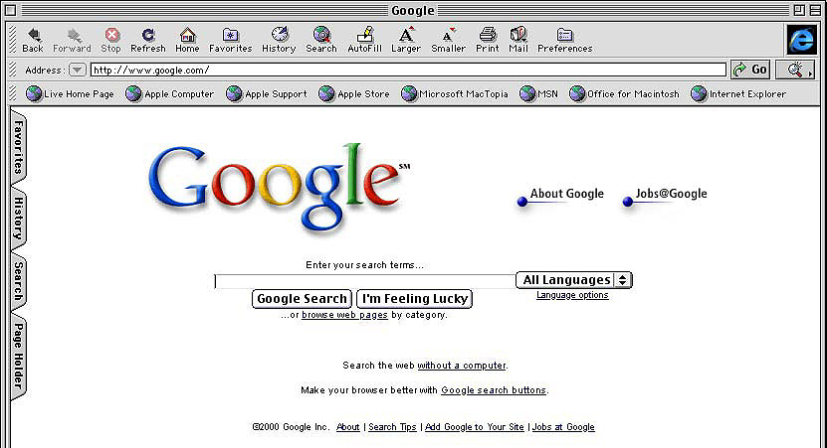
Principles: Clarity
White space
Sep 21, Fall 2006
IAT 410

Slide 24
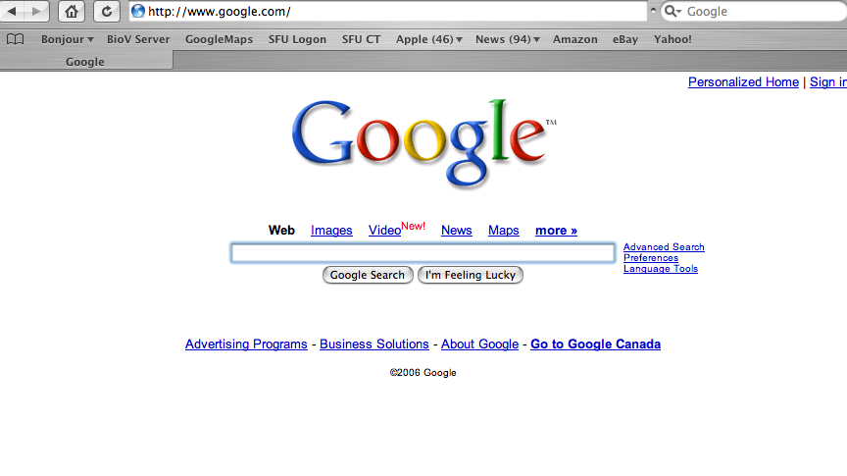
Principles: Clarity
Sep 21, Fall 2006
IAT 410

Slide 25
Principles: Consistency
Be consistent in every aspect:
In layout, color, images, icons, typography, text
Within screen, across screens
Stay within metaphor everywhere
Platform may have a style guide -- follow it!
Sep 21, Fall 2006
IAT 410

Slide 26
Principles: Alignment
Western world
  Start from top left
Allows eye to parse display more easily
Sep 21, Fall 2006
IAT 410

Slide 27
Principles: Alignment
Grids
  (Hidden) horizontal and vertical lines to help locate window components
  Align related things
  Group items logically
  Minimize number of controls, reduce clutter
Sep 21, Fall 2006
IAT 410

Slide 28
Principles: Alignment
Grids - use them
Sep 21, Fall 2006
IAT 410

Slide 29
Principles: Alignment
Grids
  (Hidden) horizontal and vertical lines to help locate window components
  Align related things
  Group items logically
  Minimize number of controls, reduce clutter
Sep 21, Fall 2006
IAT 410

Slide 30
Principles: Alignment
Left, center, or right
Ragged right or justified
Choose one, use it everywhere
Novices often center things
  Hard to read!
  No definition, calm, very formal
  Use only in small quantities
Here is
some
new text
Here is
some
new text
Here is
some
new text
Sep 21, Fall 2006
IAT 410

Slide 31
Principles: Proximity
Items close together appear to have a relationship
Large distance implies -- no relationship
Time
Sep 21, Fall 2006
IAT 410

Slide 32
Principles: Proximity
Items close together appear to have a relationship
Large distance implies -- no relationship
Time
Sep 21, Fall 2006
IAT 410

Slide 33
Principles: Contrast
Pulls you in
Guides your eyes around the interface
Supports skimming
Take advantage of contrast to guide user through hierarchy of information; add focus; or to energize an interface with “texture”
Can be used to distinguish active control
Sep 21, Fall 2006
IAT 410

Slide 34
Principles: Contrast
Can be used to set off most important item
  Allow it to dominate
Ask yourself what is the most important item in the interface, highlight it
Use geometry to help sequencing
Sep 21, Fall 2006
IAT 410

Slide 35
Agenda:
The Role of Graphic Design
Principles of Graphic Design
Animation/Rollovers
Typography
Color
Icons
Sep 21, Fall 2006
IAT 410

Slide 36
Animation/Rollovers
Blinking
  Good for grabbing attention, but easily becomes obnoxious; use very sparingly
Reverse video, bold
  Good for making something stand out
Sep 21, Fall 2006
IAT 410

Slide 37
Agenda:
The Role of Graphic Design
Principles of Graphic Design
Animation/Rollovers
Typography
Color
Icons
Sep 21, Fall 2006
IAT 410

Slide 38
Typography: White space
White space
Leads the eye
  Provides symmetry and balance through its use
  Strengthens impact of message
  Allows eye to rest between elements of
  activity (increases legibility)
  Used to promote simplicity, elegance, refinement
Sep 21, Fall 2006
IAT 410

Slide 39
Typography: Hierarchy
How do you lead the user through visual
information (by visual means)?
Some traditional navigation devices (conventions):
  Size
  Color
  Composition (where it is on the rectangle)
  Page numbers
  Type and Image emphases
Sep 21, Fall 2006
IAT 410

Slide 40
Typography
Characters and symbols should be easily noticeable and distinguishable
AVOID HEAVY USE OF ALL UPPERCASE
Studies have found that: mixed case promotes fastest reading and that 55 characters per line is optimal
Sep 21, Fall 2006
IAT 410

Slide 41
Agenda:
The Role of Graphic Design
Principles of Graphic Design
Animation/Rollovers
Typography
Color
Icons
Sep 21, Fall 2006
IAT 410

Slide 42
Color Attributes
Hue
  native color, pigment
Saturation
  relative purity, brightness, or intensity of a color
Value
  lightness or darkness of a color
Sep 21, Fall 2006
IAT 410

Slide 43
Color
Use it for a purpose, not to just add some color in
Sep 21, Fall 2006
IAT 410

Slide 44
Color Guidelines
Display color images on black background
Avoid brown and green as background colors
Be sure foreground colors contrast (in both brightness and hue) with background colors
Sep 21, Fall 2006
IAT 410

Slide 45
Color Guidelines
Use color sparingly--Design in b/w then add color where appropriate
Use color to draw attention, communicate organization, to indicate status, to establish relationships
Avoid using color in non-task related ways
(experiment coming next)
Sep 21, Fall 2006
IAT 410

Slide 46
How many small rectangles
Sep 21, Fall 2006
IAT 410

Slide 47
How many small rectangles
Sep 21, Fall 2006
IAT 410

Slide 48
How many small ovals
Sep 21, Fall 2006
IAT 410

Slide 49
How many small ovals
Sep 21, Fall 2006
IAT 410

Slide 50
Find the R
Sep 21, Fall 2006
IAT 410

Slide 51
Find the...
V
C
M
R
G
T
Q
D
P
F
A
Z
W
J
Sep 21, Fall 2006
IAT 410

Slide 52
Find the T
Sep 21, Fall 2006
IAT 410

Slide 53
Find the...
V
C
M
R
G
T
Q
D
P
F
A
Z
W
J
Sep 21, Fall 2006
IAT 410

Slide 54
Color Guidelines
Color is good for supporting search
Do not use color without another redundant cue
  Color-blindness
  Monochrome monitors
  Redundant coding enhances performance
Be consistent with color associations from jobs and cultures
Sep 21, Fall 2006
IAT 410

Slide 55
Color Guidelines
Limit coding to 8 distinct colors (4 better)
Avoid using saturated blues for text or small, thin lines
Use color on b/w or gray, or b/w on color
To express difference, use high contrast colors (and vice versa)
Make sure colors do not “vibrate”
Sep 21, Fall 2006
IAT 410

Slide 56
Color Palette
Example of Color hierarchy
Sep 21, Fall 2006
IAT 410

Slide 57
Color Associations
Culturally specific, contextually specific
Red
  hot, warning,
  aggression, love
Pink
  female, cute, cotton candy
Orange
  autumn, warm, Halloween, Cell phone
Yellow
  happy, caution, joy
Brown
  warm, fall, dirt, earth
Green
  lush, pastoral, envy
Purple
  royal, sophisticated, Barney
Sep 21, Fall 2006
IAT 410

Slide 58
Color Palettes/Suites
Designers often pick a palette of 4 or 5 colors
Variations of 2 colors
Monochromatic (variations of 1 color)
Southwestern (culturally evocative)
Sep 21, Fall 2006
IAT 410

Slide 59
Agenda:
The Role of Graphic Design
Principles of Graphic Design
Animation/Rollovers
Typography
Color
Icons
Sep 21, Fall 2006
IAT 410

Slide 60
Icon Design
Relies on drawing ability -- hire someone to do it
(here are standards and ways to critique icon design)
Avoid meaningless, gratuitous use of icons
Too many icons quickly become illegible
Sep 21, Fall 2006
IAT 410

Slide 61

Icon Design
Represent object or action in a familiar and recognizable manner
Sep 21, Fall 2006
IAT 410

Slide 62

Icon Design
Represent object or action in a familiar and recognizable manner
Sep 21, Fall 2006
IAT 410

Slide 63

Icon Design
Represent object or action in a familiar and recognizable manner
Sep 21, Fall 2006
IAT 410

Slide 64
Icon Legibility
Limit number of different icons
Make icon stand out from background
Ensure that a singly selected icon is clearly visible when surrounded by unselected ones
Sep 21, Fall 2006
IAT 410

Slide 65
Icon Legibility
Make each icon distinctive (legible)
but
Make icons harmonious members of icon family
Avoid excessive detail
Accompany with names
(though it shouldn’t be necessary)
Sep 21, Fall 2006
IAT 410

Slide 66

Icon Design
Is the symbolic aspect of the icon meaningful?
Sep 21, Fall 2006
IAT 410

Slide 67
Role of Graphic Design in HCI
The “look and feel” portion of an interface:
What someone initially encounters
  Sets a framework for understanding content
Sep 21, Fall 2006
IAT 410

Slide 68
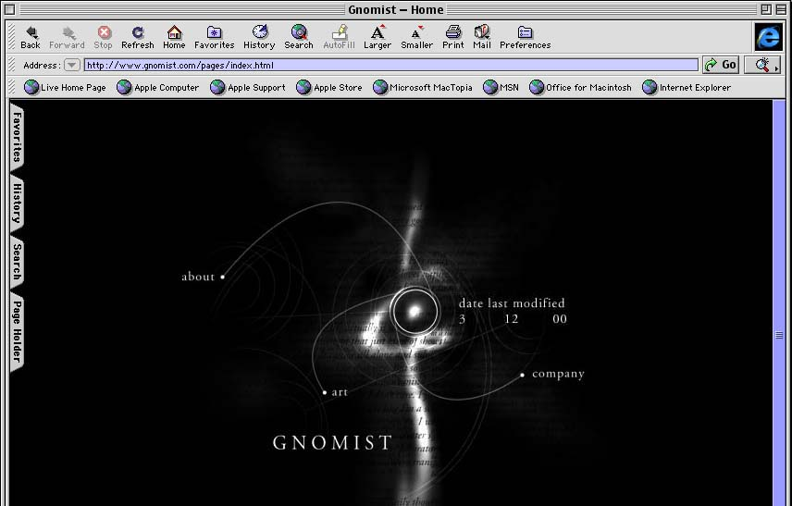
Role of Graphic Design in HCI
The “look and feel” portion of an interface:
What someone initially encounters
  Sets a framework for understanding content
Sep 21, Fall 2006
IAT 410

Slide 69
Graphic Design
Like any design job, there must be a logic to the visual design
The logic drives
  Color scheme
  Materials choices
  Lighting style
  Fonts
  etc.
Sep 21, Fall 2006
IAT 410

